Slide 1
Contactless Radar-Based
Heart Rate Monitoring Device
ZHAW PM4 Electronics Project
Thomas Perri | Bogdans Grebnevs
01/14
Notes:
No voiceover. Static title slide with minimal project title and ZHAW PM4 label.

Slide 2
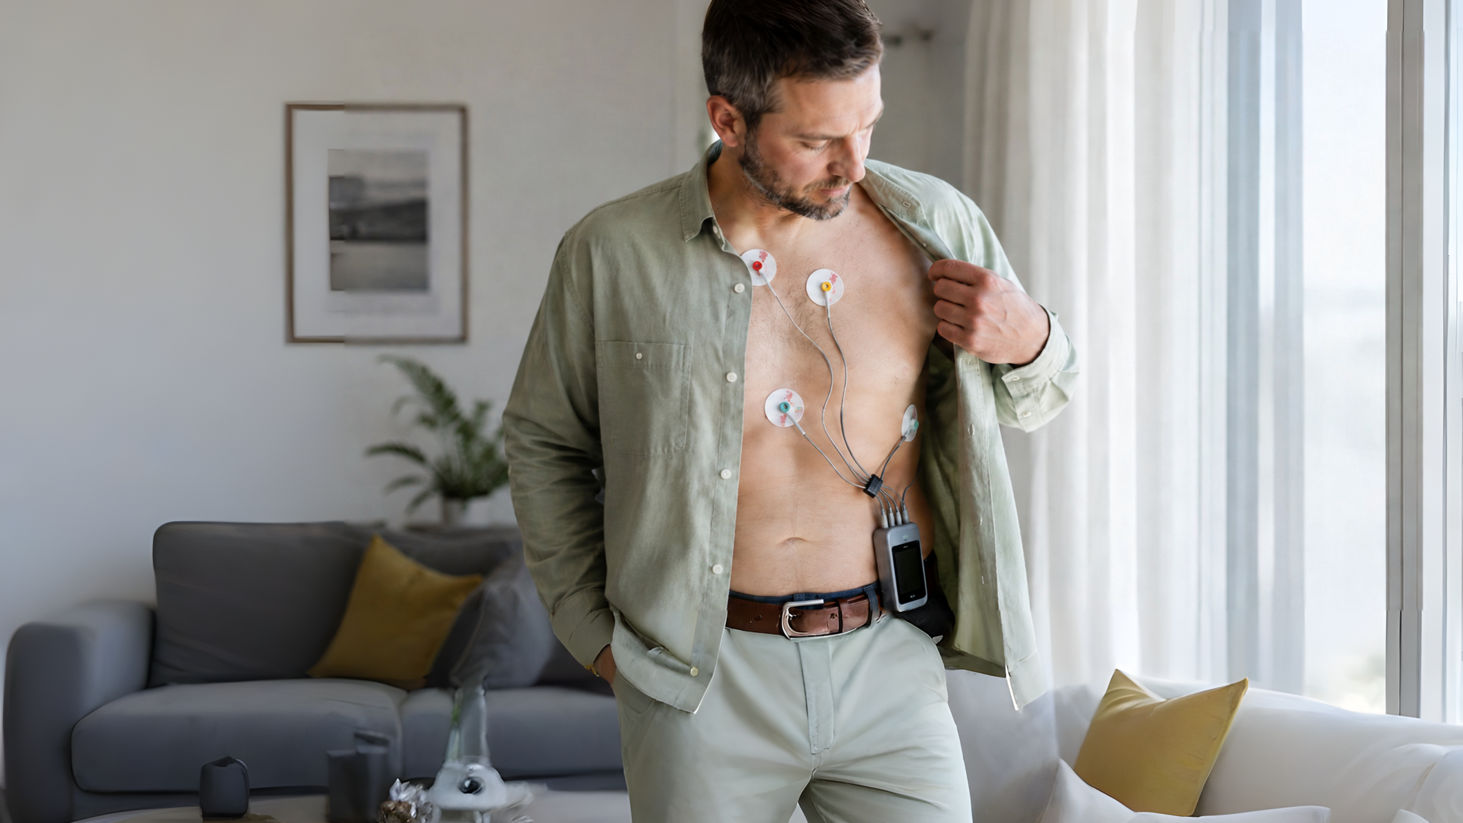
Problem
0:07-0:18
Heart rate.
Still contact-based.
Electrodes
Straps
Wearables
02/14
Notes:
Heart rate tells a lot. But measuring it often still means contact: electrodes, straps, watches, or wearable sensors.

Slide 3

Need
0:19-0:32
The ideal measurement is...
comfortable
continuous
contact-free
03/14
Notes:
For sleep, long-term monitoring, or sensitive users, contact can become the limitation. The ideal measurement is comfortable, continuous, and almost invisible.

Slide 4
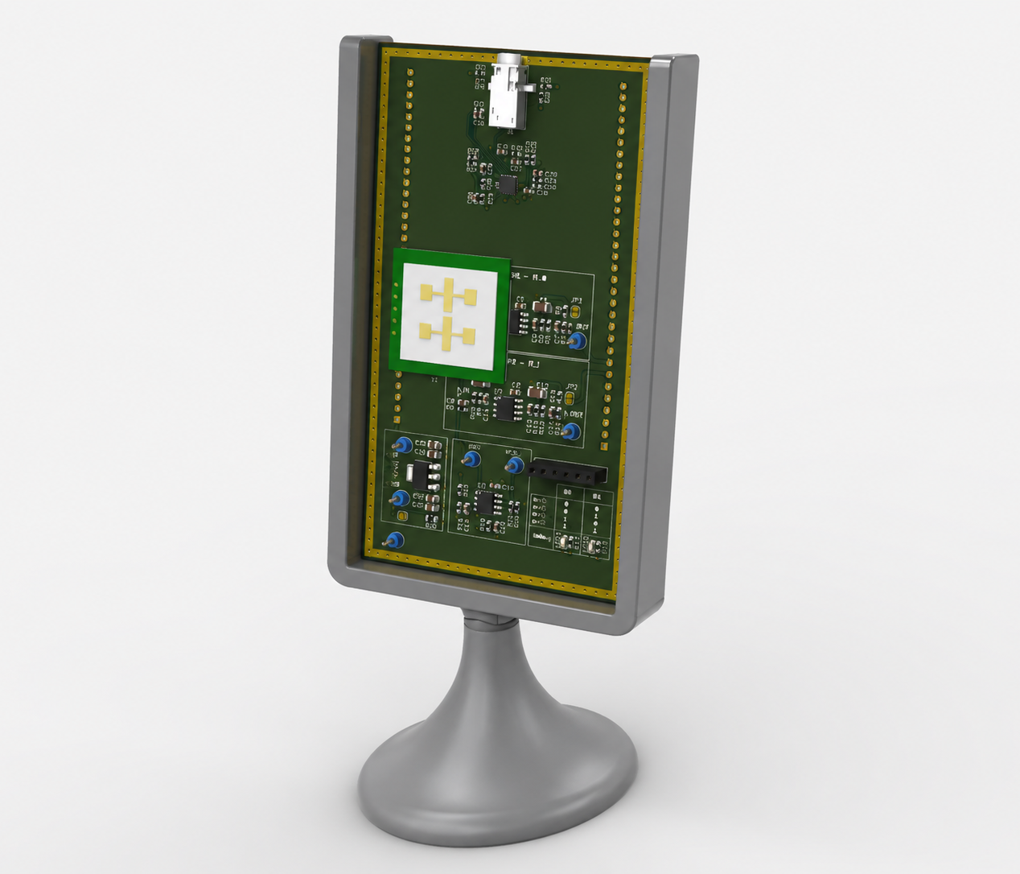
Device Concept
0:33-0:48
Detects chest movement
without touching the body.
Contactless
Real-time
LCD Display
04/14
Notes:
This device detects heart-rate-related chest movement without touching the body. It processes the radar signal in real time on an STM32 microcontroller and shows the result directly on an integrated display.

Slide 5

Doppler Principle
0:49-1:05
Small cardiac movements
shift the reflected phase.
Measurable heartbeat pattern
Chest
05/14
Notes:
The principle is Doppler sensing. A microwave radar module sends a signal toward the chest. Small movements caused by cardiac activity change the phase of the reflected signal, creating a measurable heartbeat pattern.

Slide 6
System Architecture
1:06-1:22
Radar front end to embedded visualization
K-LC5
Radar
Analog
Front End
STM32F429
Discovery
LCD
Touchscreen
OpenLog
SD Card
I/Q acquisition
Real-time processing
Touch UI + logging
06/14
Notes:
Inside the system, the K-LC5 radar module is connected to an analog front end and an STM32 Discovery board. The microcontroller acquires the I and Q radar channels, processes them, and drives the LCD touchscreen.

Slide 7
Standalone Demonstration
1:23-1:39
VIDEO PLACEHOLDER
Show in this clip
Standalone operation
Heart-rate display
OpenLog close-up
SD card logging
Live board operation
Insert clip: STM32 + LCD running without external PC
07/14
Notes:
The complete processing chain runs directly on the embedded platform. No external PC is required during operation, while heart-rate data can also be logged to an SD card with the integrated OpenLog module for later analysis.

Slide 8
Processing Window
1:40-1:55
Sampling and analysis timing
100 Hz
512
5.12 s
2.56 s
sampling
samples/channel
window length
update interval
50% overlap
New result every 2.56 seconds while using 5.12 seconds of signal data
08/14
Notes:
The radar signals are sampled at 100 hertz. Each analysis window contains 512 samples per channel, equal to 5.12 seconds of data, with updates every 2.56 seconds using 50 percent overlap.

Slide 9
Signal Analysis UI
1:56-2:12
VIDEO PLACEHOLDER
I/Q signals
FFT spectrum
Dominant peak
Time signal, FFT spectrum, peak detection
Insert UI recording; show filter/effect menu for 1-2 seconds
09/14
Notes:
From the sampled I and Q signals, the system computes the frequency spectrum and detects the dominant heart-rate peak. The interface also provides analysis tools such as selectable filter modes for testing and development.

Slide 10
Interface Walkthrough
2:13-2:30
Time Signal
VIDEO PLACEHOLDER
FFT Spectr
Peak Detect
EKG BPM
Log file insert
Touchscreen page walkthrough
Insert UI recording: Time Signal, FFT Spectr, Peak Detect, EKG BPM
10/14
Notes:
The interface makes the signal processing visible: time signal, FFT spectrum, peak-frequency readout, ECG monitor page for reference comparison, and logged heart-rate data for offline evaluation.

Slide 11
Debugging and Validation
2:31-2:43
VIDEO PLACEHOLDER
User sees the result
and the intermediate data.
BPM estimate
Time signal
FFT spectrum
Peak position
ECG comparison
Zoomed UI details
Insert clip: spectrum peak plus ECG BPM reference page
11/14
Notes:
This allows the user to see both the final heart-rate estimate and the intermediate signal and spectrum, supporting debugging, validation, and further development.

Slide 12
Technical Summary
2:44-2:55
Range
Spectrum
up to about 1 m
+/- 4 Hz display
Validation
Logging
ECG comparison
SD card via OpenLog
12/14
Notes:
The device targets short-range operation up to about one meter. The displayed spectrum covers approximately plus or minus four hertz, with ECG comparison used for validation.

Slide 13
FFT Resolution and Interpolation
2:56-3:16
Peak is refined between raw FFT bins
0.195 Hz bin spacing
11.7 bpm per bin
sub-bin interpolation
Accuracy still depends on signal quality, leakage, motion artifacts, and temporal stability.
Frequency bins
13/14
Notes:
The FFT bin spacing is approximately 0.195 hertz, or 11.7 beats per minute. However, parabolic peak interpolation refines the peak position, so the BPM output is not limited to raw FFT-bin steps. Practical accuracy still depends on signal quality, leakage, motion artifacts, and temporal stability.

Slide 14
Contactless Radar-Based Heart Rate Monitoring Device
3:17-3:27
Compact platform for comfortable vital-sign monitoring
Contactless heart-rate monitoring
Short-range operation: up to about 1 m
QR / repo
placeholder
Real-time STM32F429 processing
Touch UI: time, FFT, peak, ECG pages
FFT bin spacing: about 0.195 Hz
Accuracy: currently under validation against reference ECG
Replace with repository or demo link
Authors: Thomas Perri, Bogdans Grebnevs
Date: add recording or submission date
14/14
Notes:
Contactless sensing, real-time embedded processing, touchscreen visualization, ECG-supported validation, and SD-card logging come together in one compact platform for comfortable vital-sign monitoring.

